Slide 1
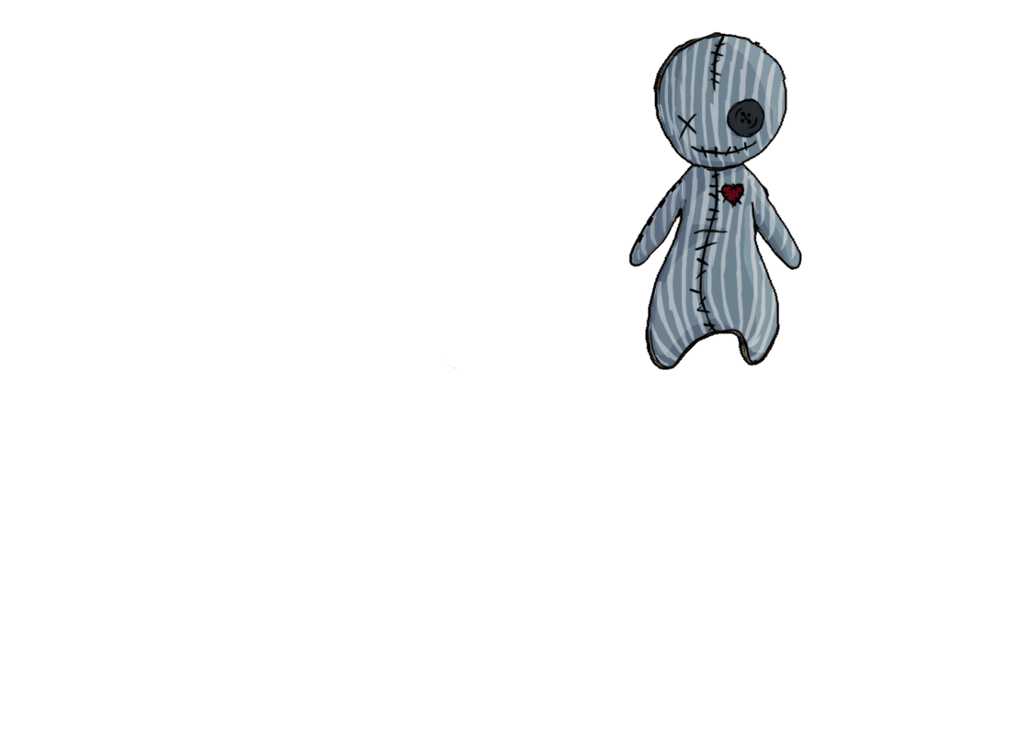
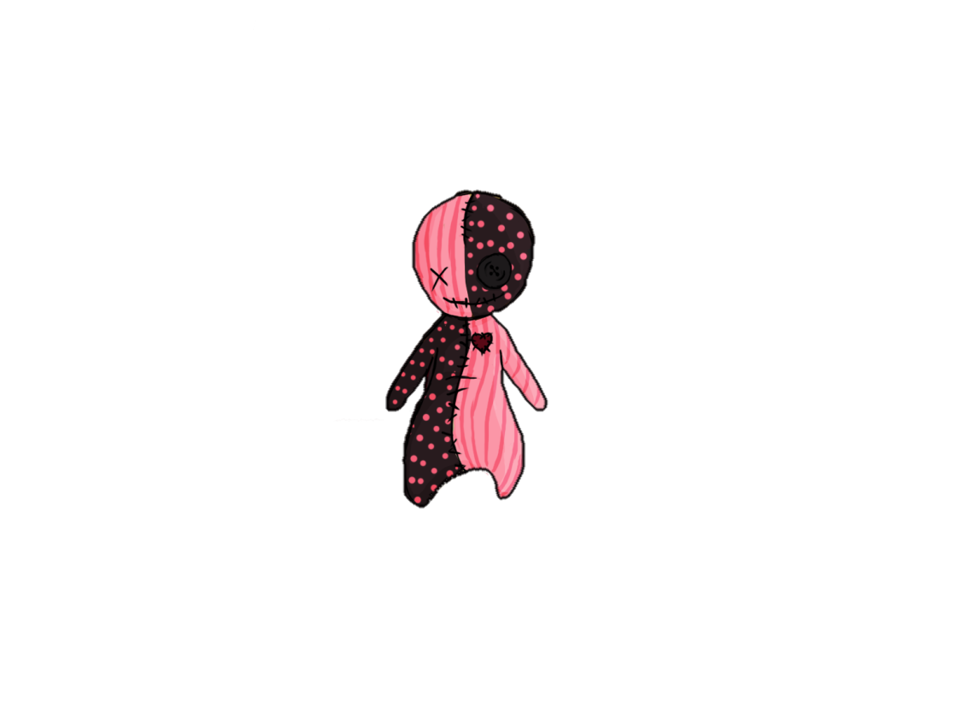


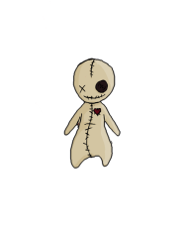
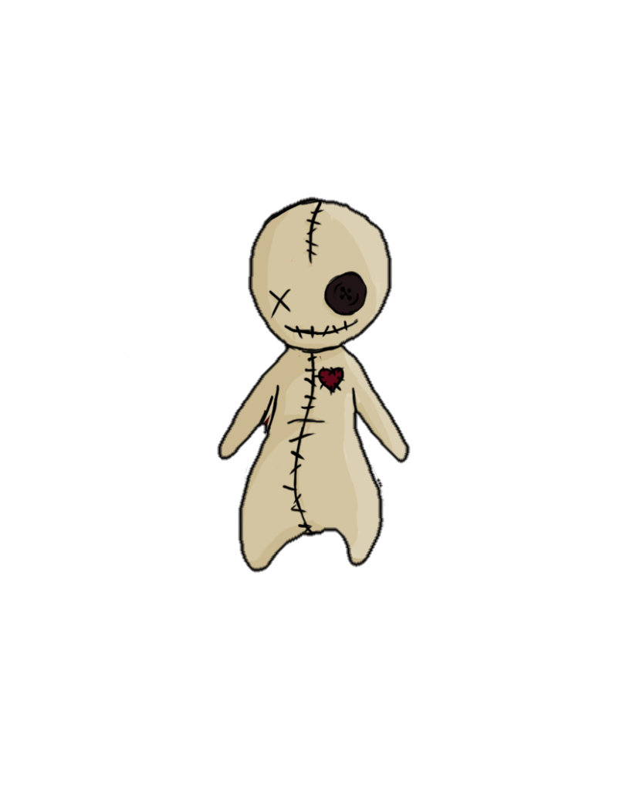





Doll 13
by
Notes:
Hello and welcome to the Goldmaster presentation of „Doll 13“ made by Team Rex.

Slide 2

Table of Contents
Review
Team Rex
Gate 3 Promises vs. Present
Let’s Play!
Questions
Notes:
First I want to give you an overview of what you will see today:
Since many of you don’t know the game at all, I will start with a review of our vision and give you some basic information about the game itself.
After that I will present you the team that made all of this possible and give you a quick overview of what each of them contributed to the game.
Afterwards we will see the goals we had for today and check if we were able to fulfill them and then we will directly dive into the game.
Die heutige Praesentation wird kurz und knackig, damit ihr euch moeglichst schnell einen direkten Eindruck vom Spiel selbst machen koennt. Kurz zum Ablauf: Zuerst werde ich euch ein kurzes Review zum Spiel und unserer Vision davon geben und anschliessend werde ich die Ziele, die sich unser Team beim letzten Gate gesetzt hat, und unseren tatsaechlichen Stand heute durchgehen. Danach praesentiere ich euch die neuen Ziele, die wir uns bis zum Goldmaster gesetzt haben und dann geht es auch schon weiter zum Spiel selbst. Kommen wir gleich zum Review. ☺

Slide 3
Review
Vision: Doll 13 is a 3D puzzle-adventure for lovers of the occult with minimized stealth-elements.
Game Type: 3D Platformer
Game Mode: Singleplayer
Genre: Supernatural Adventure
Platform: PC
Engine: Unity
Notes:
Doll 13 is a 3D puzzle-adventure for lovers of the occult with minimized stealth-elements. We tried to create a game where you can explore everything at your own pace and where you have to take a look around to be able to grasp the whole story. It’s a singleplayer game for PC where you play a little Voodoo-Doll that came alive in the basement of a secret base and now trys to escape from there. The game takes place in the 1950s and we tried to achieve a low-poly
Doll 13 ist ein 3D puzzle-adventure mit stealth-elementen fuer Freunde des Okkulten. Es ist ein Singelplayerspiel fuer den PC in dem der Spieler eine kleine Voodoo-Puppe steuert, welche im Keller einer Geheimbasis zum Leben erwacht ist und nun versucht daraus zu fliehen. Das Ganze spielt in den 1950ern und wir versuchten das Spiel so zu gestalten, dass der Spieler mit Hilfe von Storytelling-Elementen im Spiel die Hintergrundgeschichte dazu nachvollziehen bzw. Aufdecken kann.
Nun zu den Zielen die wir uns bis heute gesetzt hatten.

Slide 4
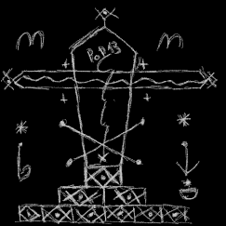
Team Rex
Producer:
Sonja Köck
Programmer:
Artjom Schmitke
Game Designer:
Tobias Schuster

Slide 5
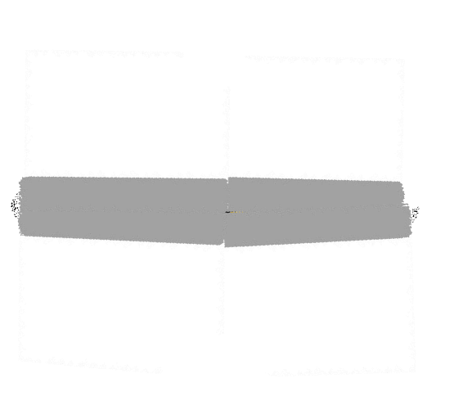
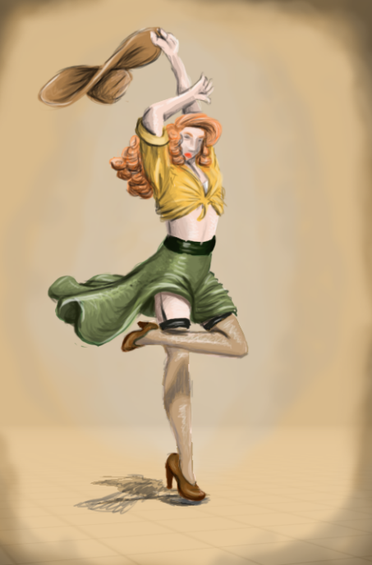
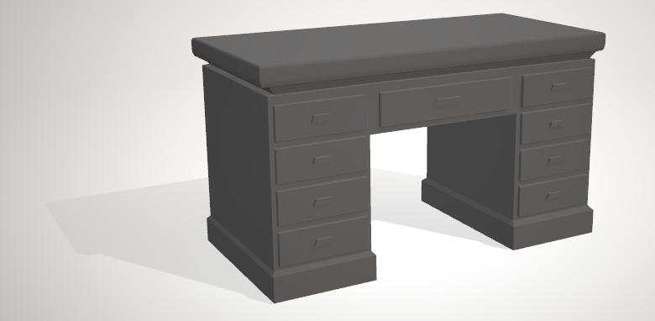
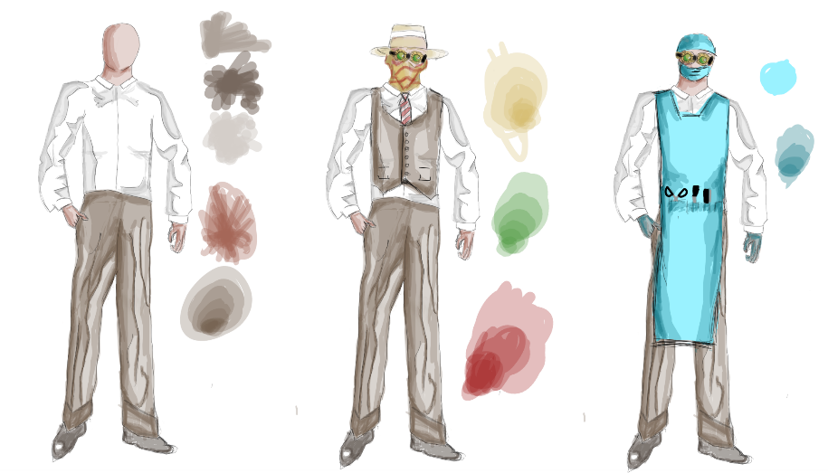

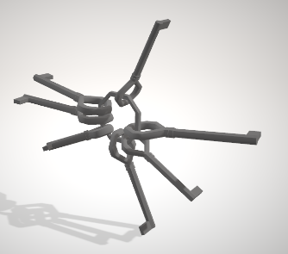
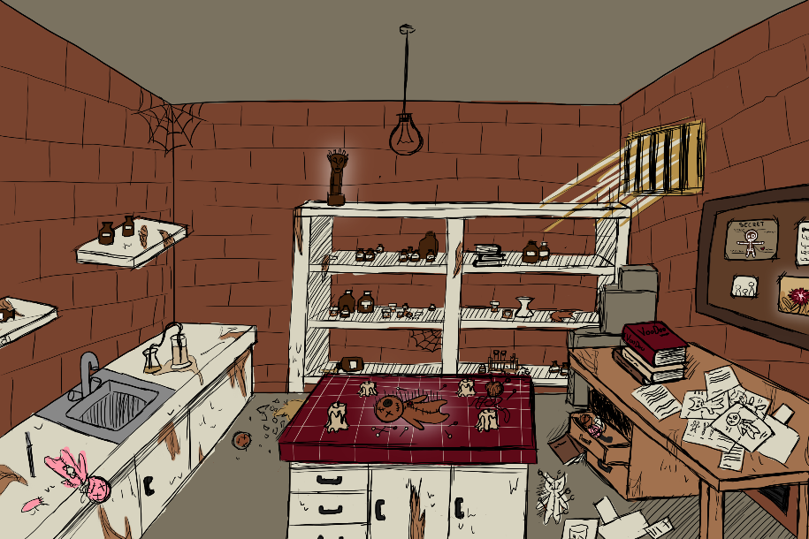
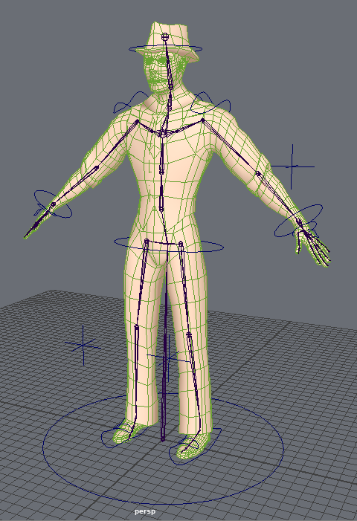
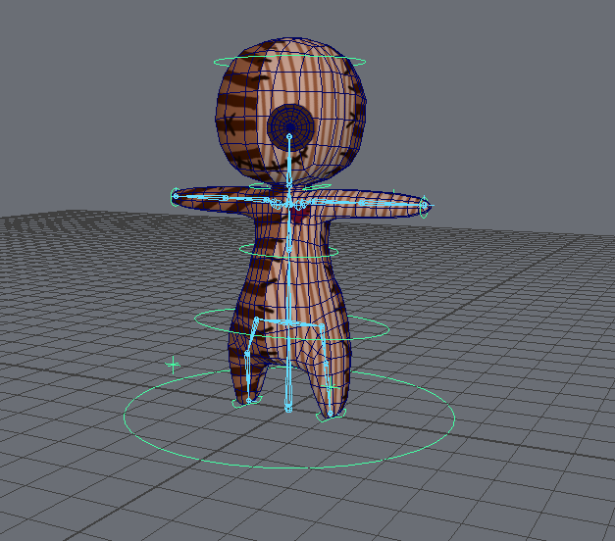
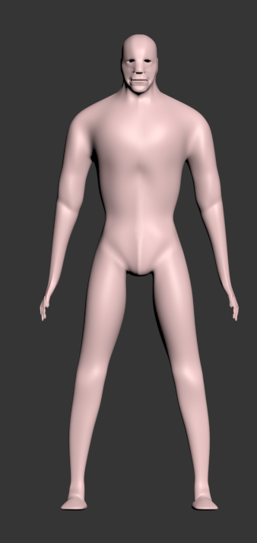
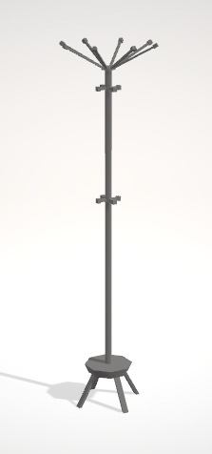
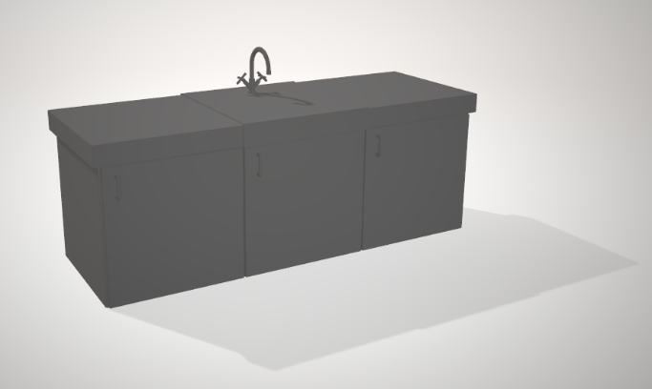
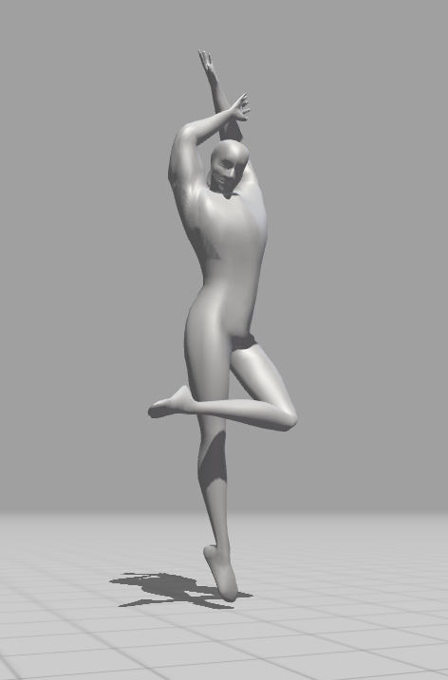
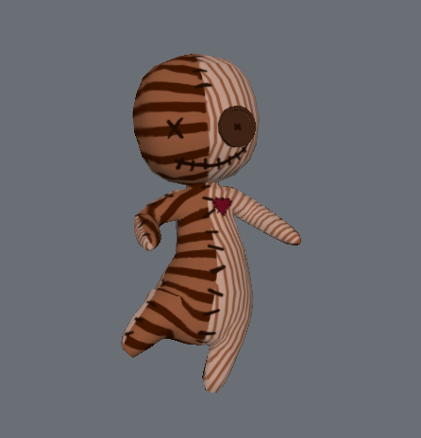
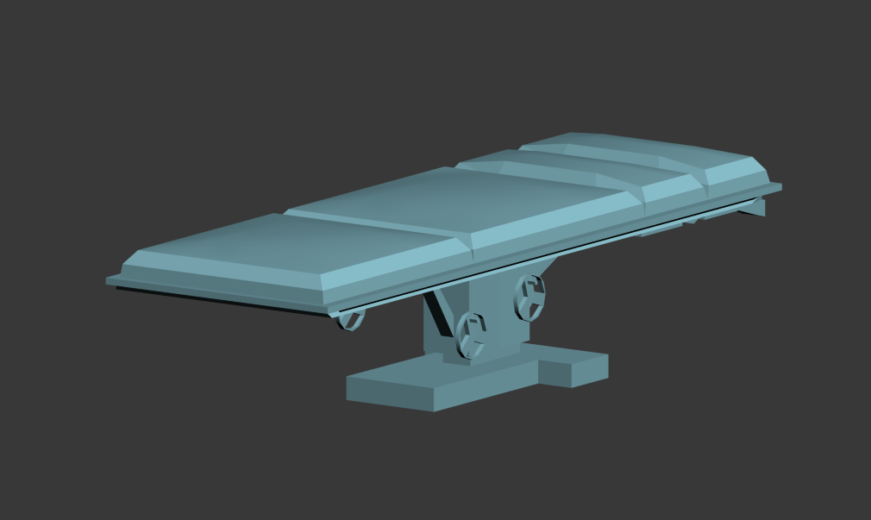
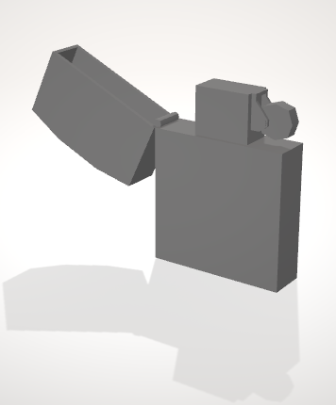

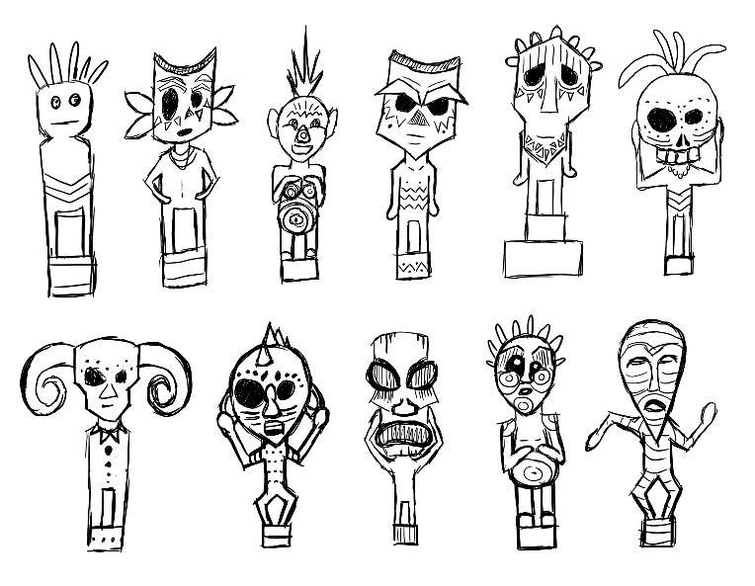

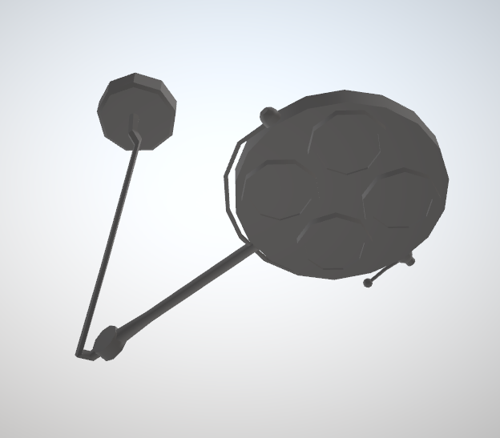
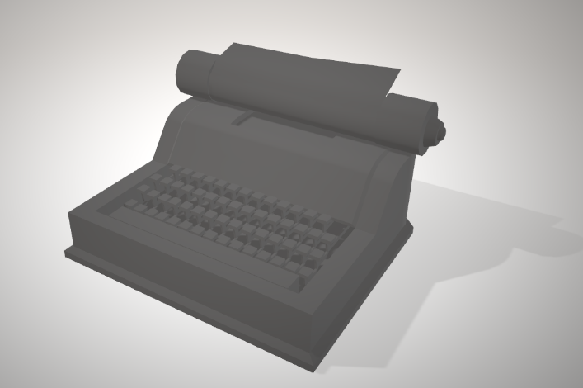
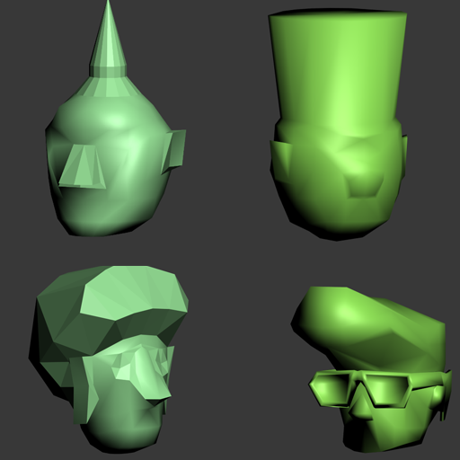
Team Rex
Artists:
Michelle Gaußmann
Jesse Haines
Levin Lang
Michelle Mohn
Marlou Nolting
Notes:
So, lets get to the main part of our team: our artists! Michelle Gaussmann is our animator. Not only did she make the skin, rig and all the animations of our main character…
… she also made a retopology of the guard model, skinned and rigged it and made all the animations for it as well. Since our guard has some really nice legs she also decided to use him as a model for some posters she made for the game.
Jesse Haines is our 3D-Specialist for some of the more complex 3D-models in the game
Levin Lang is our jack-of-all-trades. He provided us with various concepts throughout the production, created the basic body of our guard as well as several 3D assets and decals and also made some small animations for the game.
Michelle Mohn also is very flexible regarding 2D and 3D. She made some nice concepts for our tutorial room and our fetish but mostly created the tons of 3d assets that you can see everywhere in the game.

Slide 6

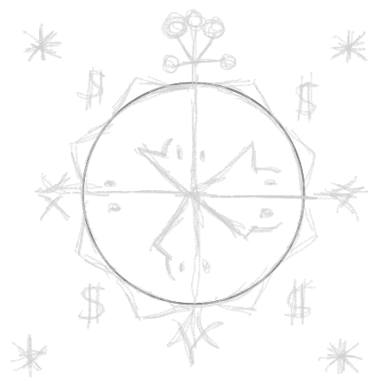
Gate 3
Promise:
Present:
Tutorial
Menu
Polished Game

Slide 7

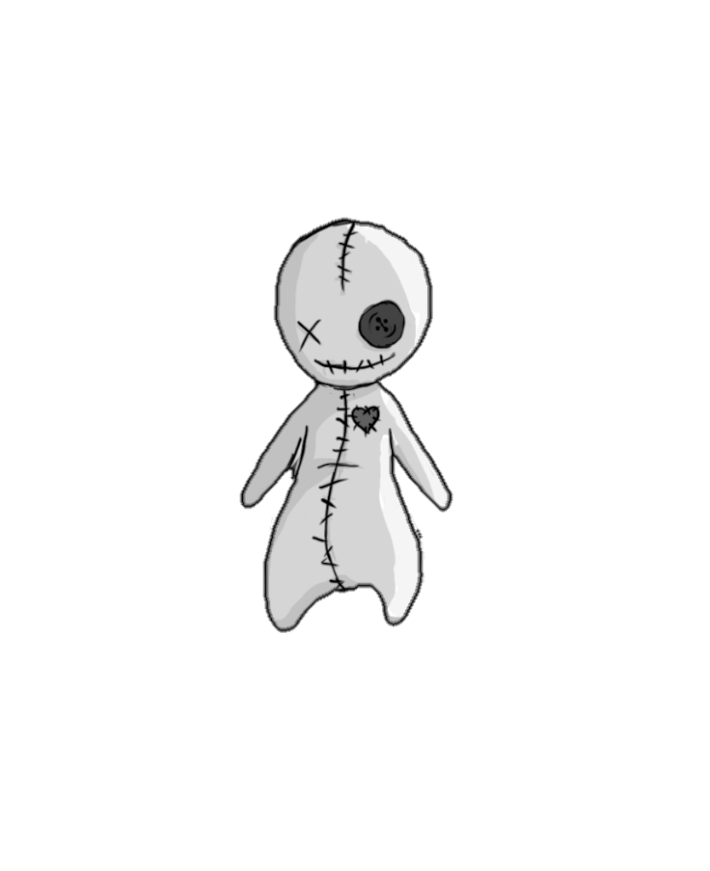
Let’s play!

Slide 8

Any Questions?
Team-Rex
Games Academy Frankfurt
Hanauer Landstraße 146
60314 Frankfurt am Main
Sonja.Koeck@games-academy.de

